Slide 1
14D_MotorTest
Motion control example
Nucleo_F401 and X-Nucleo_IHM04A1
With nBlocksStudio

Slide 2
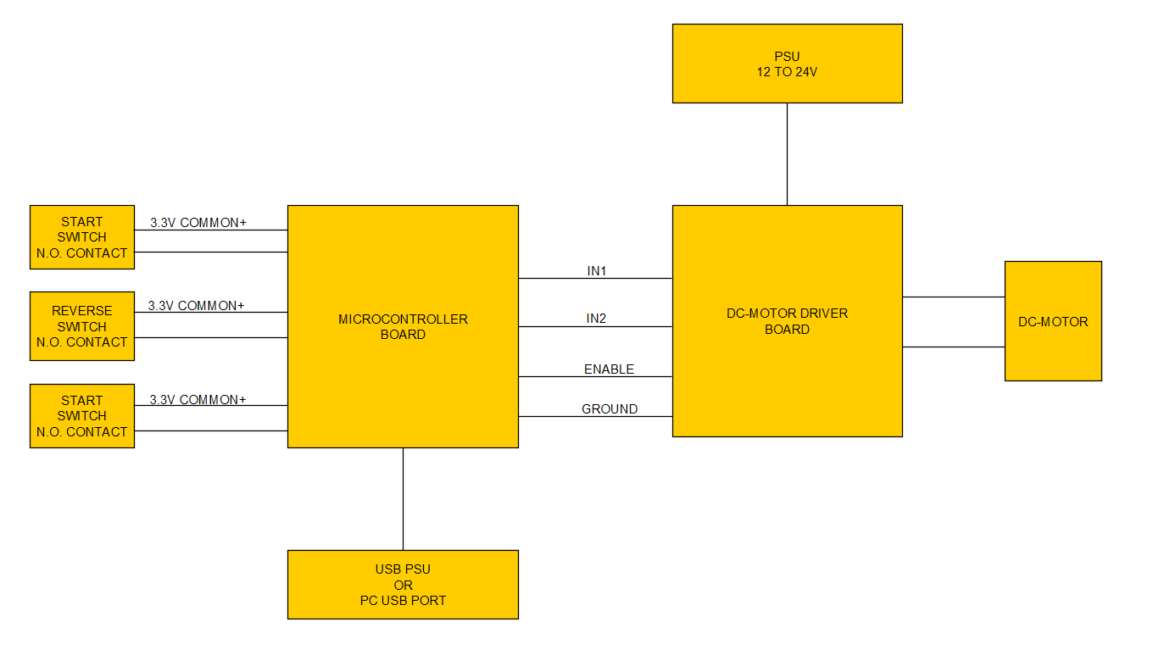
BLOCK DIAGRAM

Slide 3
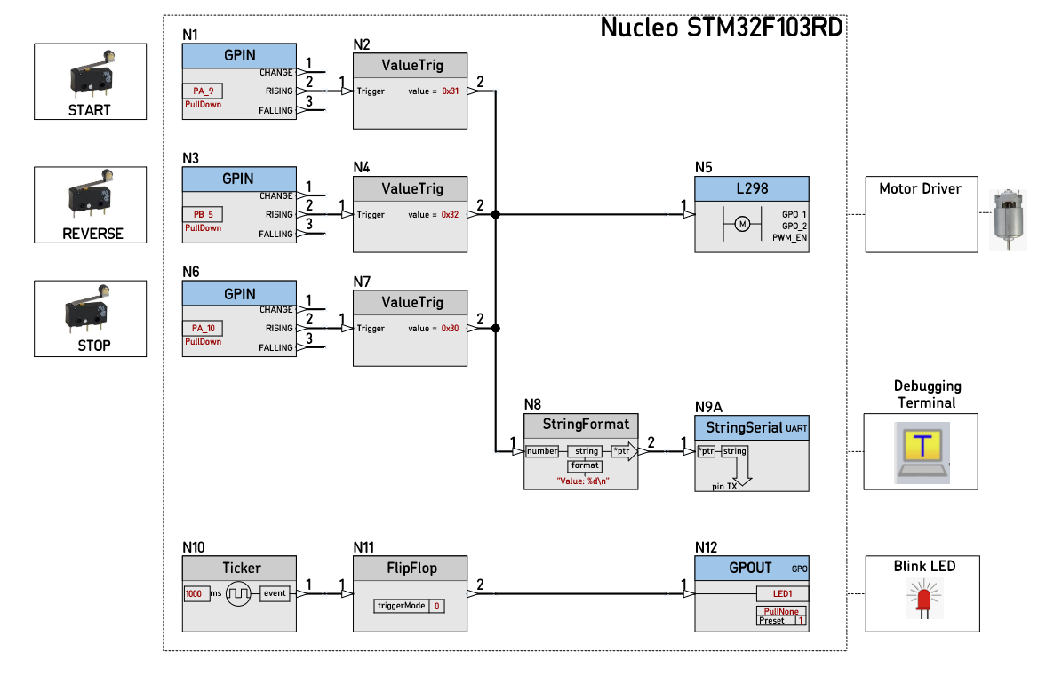
nBlocksStudio Design

Slide 4
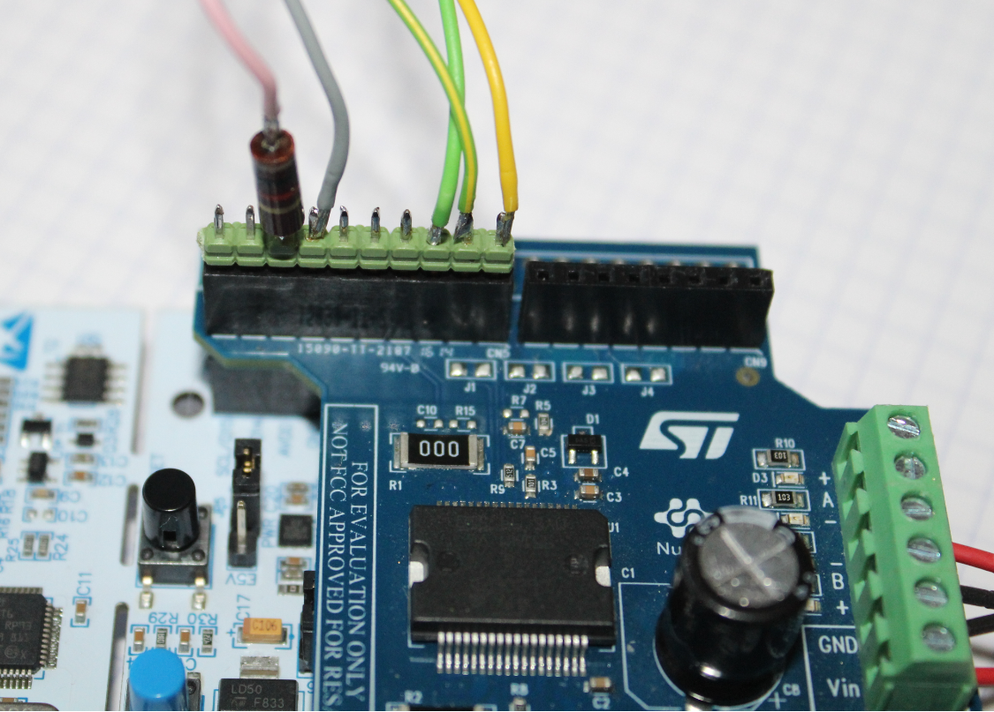
SWITCHES CONNECTION
GROUND
REVERSE
COMMON+
3.3V
TO SWITCHES
START
STOP
1K RESISTOR IN SERIES
TO THE SWITCHES
PROTECTS THE BOARD
FROM SHORT-CIRCUIT
3.3V TO GND
1K Ohms

Slide 5
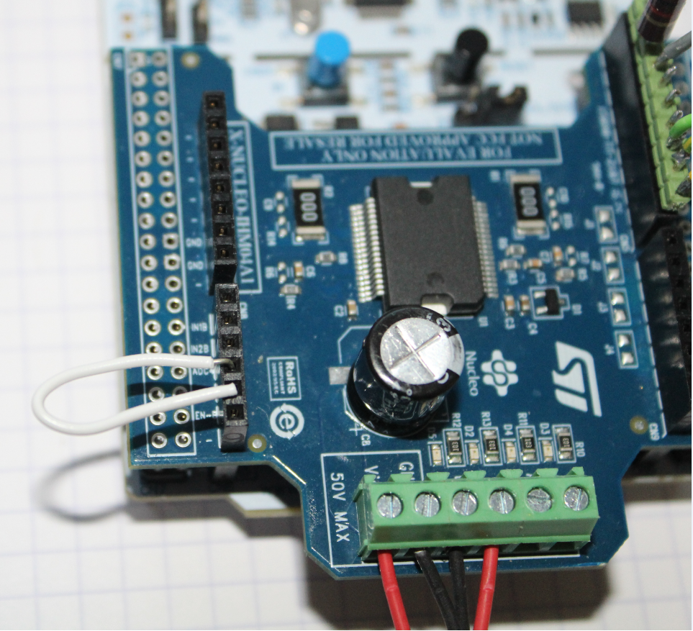
MOTOR-CONNECTIONS AND BRIDGE
12-24V
GROUND
MOTOR
MOTOR
BRIDGE
MANDATORY

Slide 6
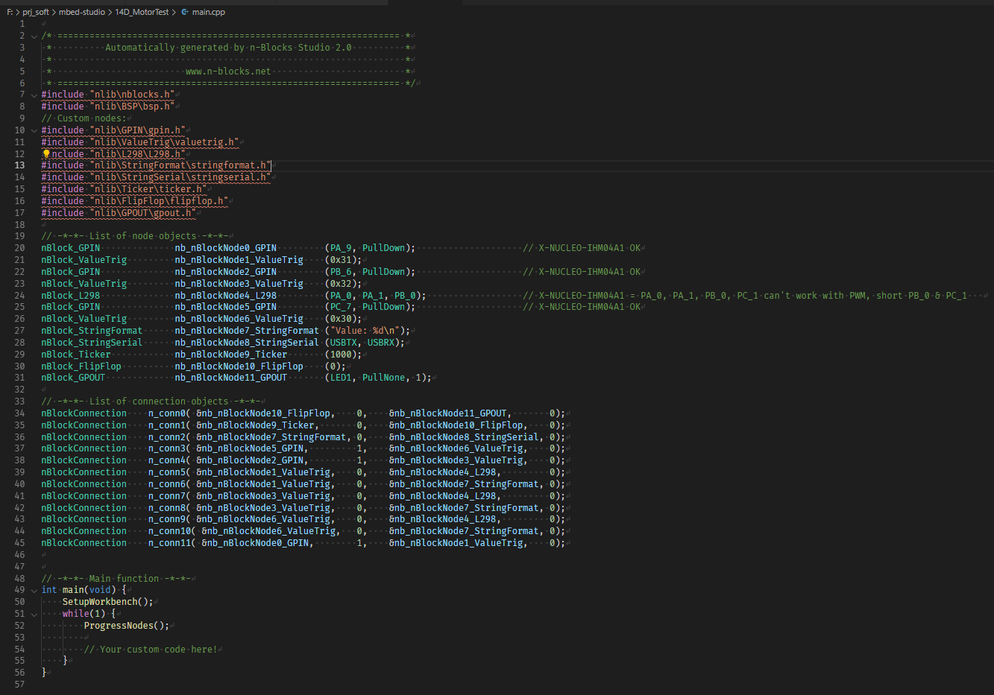
main.cpp

Slide 7
A simple way to flash the Nucleo board
Connect the Nucleo board to the PC
Wait until it appears as a disk drive (mbed)
Copy your .hex or .bin file to the new mbed drive

